Slide 1
Executive Summary | Securities Lending Business Assessment (US)
Objective
Assess the current state of institution’s US Securities Lending business, regulatory landscape and identify growth opportunities
Business Context
The institution runs a securities lending business in the United States market, where it supports both sides of the transaction:
Beneficial owners (lenders) → the supply side (they provide securities to lend)
Borrowers → the demand side (they borrow securities for shorting, market making, settlement, hedging, etc.)
Key Highlights
Current state of the business: operating model, product coverage, economics, risk profile
Market dynamics (US): demand/supply drivers, growth trends, on-loan balances, specials/ETFs
Regulatory pressures: transparency/reporting, controls, capital/leverage constraints
Opportunities to differentiate and build a stronger securities lending platform
Prepared by Nihal Jani

Slide 2
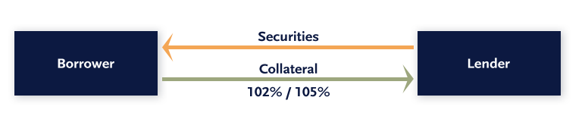
Overview on Securities lending
Current state of Institution Business
Securities lending is when a lender temporarily transfers securities to a borrower in exchange for collateral and fees, with the borrower obligated to return equivalent securities.
Key mechanics:
Supply: Institutional investors (pension funds, mutual funds, insurance cos.) lend via custodian/agent intermediaries to monetize idle inventory to enhance returns and offset fund expenses.
Demand: Hedge funds access securities through prime brokers for short-selling, hedging, and market-making
Economics: Revenue from lending fees (non-cash collateral) or reinvestment spread (cash collateral)
Product coverage: US equities, equity swaps, fixed income, ETFs (dual-sided platform)
Current state working assumptions*:
Operating model:
Hybrid agency/principal model serving both beneficial owners and borrowers
Moderate scale inventory and borrower activity
Semi-automated workflows with legacy infrastructure; manual interventions required for recalls, substitutions, and exception handling; limited real-time inventory visibility and pricing intelligence
Mid-tier market position vs. top custodians & prime brokers
Key gaps Identified
Manual lifecycle management driving operational costs
Limited electronic execution capabilities (comparison to peers)
SLATE reporting readiness
*Assumptions based on industry benchmarks; to be validated through internal assessment

Slide 3




Market Dynamics & Insights
Global Trends *
Outlook*
Global Securities on Loan
~$3.25Tn ⬆22% YoY (Oct 2025)
Global Revenues
~$14.91B ⬆27% YoY (Oct 2025)
Projected to reach
$21.5Bn by 2034
US Trends
Securities on Loan
~$692Bn ⬆30% YoY (Oct 2025)
Equity Revenues
~$4.8Bn ⬆24% YoY (Oct 2025)
Growing at CAGR
5.7% from 2025-2034
Demand Drivers
US equity lending performed strongly in 2025: equities generated ~$4.8B in annual securities lending revenue, up ~24% YoY (amid AI speculation, M&A activity, tariffs, rate cuts and political volatility).
Equities + ETFs dominate borrow demand (short selling + hedging + market making inventory needs) as revenue from ETF lending rising sharply from $344 million in 2024 to $626 million in 2025.
ETFs/ETPs structurally increasing lendable supply and borrow activity
Volatility + event-driven positioning increases specials demand and fee dispersion
Rates environment impacts collateral economics, increasing focus on fee optimization vs reinvestment spread
Implication:
Market growth + higher volatility increases need for real-time inventory, dynamic pricing, and automated lifecycle processing (STP).
*Source: Data Lend, S&P Global Market Intelligence & Allied Market Research

Slide 4
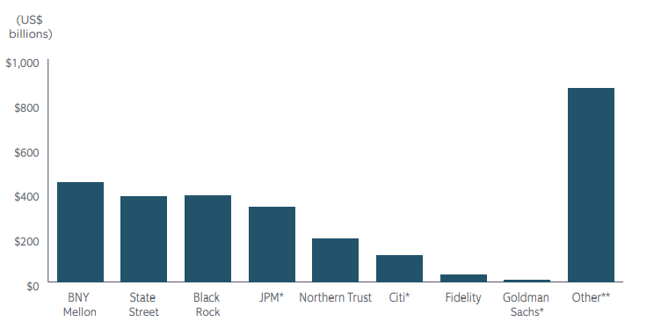
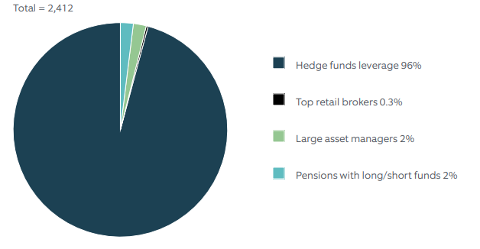
Competitive Landscape
1. Agency lending is custodian-dominated:
Top custodians (NT, BNY Mellon, Citi, JPM, State Street) lend ~53% of assets, leveraging indemnity strength + integrated post-trade + collateral/liquidity services.
2. Borrower-side franchise is growing (Prime finance tailwinds)
Prime brokerage / equities financing demand accelerated in 2025, driven by increased hedge fund activity and leverage.
Borrow activity is concentrated and consolidating as top 10 primes drive ~80% of borrow, while the top 3 (JPM/GS/MS) generated 56% of securities lending + margin financing revenues in 2021 (up from 50% in 2019).
Key demand concentrated among large multi-manager funds driving volumes and scale of business (D.E. Shaw, Citadel Advisors, Point72, Bridgewater)
3. Platforms are rising → shift toward infrastructure + connectivity
Industry shifting from fragmented bilateral workflows → centralized electronic execution + standardized connectivity
EquiLend is becoming core market infrastructure (e.g., BNY minority stake; supported by major dealers & asset managers)
Electronic securities finance flow accelerating: EquiLend NGT trades +34% YoY in 2025
Competitive landscape is shifting from “inventory-only” to “platform-led infrastructure”: alongside EquiLend’s growth as an electronic trading utility, providers like Pirum (lifecycle automation/connectivity) and Broadridge SFCM (front-to-back securities finance + collateral tech) are strengthening the ecosystem—raising the bar on STP, connectivity, and controls.
Next infrastructure wave: growing industry focus on DLT / blockchain-enabled post-trade (tokenized collateral, improved collateral mobility, and enhanced auditability)
SECURITIES LOANS O/S DEC 2021
END-BORROWERS OF SECURITIES LOANS JAN’22
*Source: Finadium Survey Analysis, S&P Global Market Intelligence

Slide 5
Regulatory Landscape - USA
Key regulations
SEC Rule 10c-1a / FINRA SLATE (Transparency): Mandates broker-dealers to report covered securities lending transactions to FINRA’s SLATE system, increasing market-wide transparency; implementation of same extended to Sep 28, 2028, from Jan 2026.
Basel III/IV (Capital & RWA constraints): higher/changed capital requirements, impacting banks’ willingness to intermediate and driving more selective and optimized lending.
Dodd-Frank Act & Investor protection: Post-crisis reforms increased standards, stronger protections and disclosures for lending of customer fully paid or excess margin securities under FINRA Rule 4330, increasing compliance controls and operational oversight requirements.
Current & Emerging Trends
T+1 settlement compresses post-trade timelines → higher need for STP, faster recalls/returns, and stronger fails management.
Counterparty risk controls: tighter monitoring, concentration limits, margin sufficiency → push toward real-time exposure views.
Central clearing evolution: broader push for clearing in rates/repo ecosystem impacts securities finance desks → workflow and collateral implications.
Risk & transparency tightening: greater focus on counterparty risk controls and enhanced investor reporting/visibility.
Automation & Technology: increasing compliance and cost pressure driving adoption of automated recalls, exception/fails management, and digital regulatory reporting (e.g., SLATE).
*Source: SEC.gov, Industry Reports (Northern Trust, EY)

Slide 6
Particulars | Supply-side (Beneficial Owners) | Demand-side (Borrowers)
Commercial/Growth | Supply Advantage – Lenders Expand inventory access (mandates / exclusives) Increase utilization + transparency | Demand Advantage (Borrower Distribution) Increase borrower adoption and usage across key client segments. Faster locate + higher locate-to-borrow conversion
Risk / Efficiency | Economics Advantage (Pricing + Collateral) Price loans based on demand and scarcity (easy-to-borrow vs hard-to-borrow) to maximize fee capture Collateral optimization (cash/non-cash collateral, margin efficiency) | Platform Advantage (STP + Controls-by-Design) • Automate lifecycle (recalls/returns/rerates/substitutions) • Compliance-ready reporting (SLATE) with audit trails Transforming Securities Finance Through Distributed Ledger Technology (DLT) Settlement speed: move from T+1/semi-automated → near real-time / 24×7 Execution & liquidity: from opaque/manual negotiation → more transparent, automated matching / smart-contract execution Margin & collateral: from periodic MTM → real-time margining + collateral mobility Reporting & auditability: from batch reconciliation → immutable audit trails, lower reconciliation burden
Differentiation Opportunities
Key takeaway: Intermediary differentiation is shifting from inventory-only to platform-led execution:
Distribution + pricing/collateral + optimization + automation + controls (with DLT as the next infrastructure frontier).
Example: Broadridge Securities Finance and Collateral Management (SFCM), EquiLend 1Source, Equilend NGT etc.

Slide 7
Execution Roadmap & Success Metrics
Phase 1
(0-9Months)
Regulatory Ready + Quick Wins
Phase 2
(9-18Months)
Scale platform + optimize economics
Phase 3
(18-36Months)
Next-gen platform capabilities
SLATE reporting readiness
Automation for recalls/returns + exception workflow
Outcome: faster cycle times, fewer exceptions, reporting readiness
Dynamic pricing
Expand distribution: borrower connectivity + APIs, improve locate-to-borrow conversion
Outcome: revenue uplift + improved margin per trade + improved borrower experience
Unified real-time platform
DLT-enabled post-trade modernization shared record / reduced reconciliation
Outcome: differentiation through scalability, resilience, and cost efficiency
Prioritization approach > Revenue impact, Risk/compliance urgency and Feasibility/time-to-value
Focus on platform changes that unlock multiple benefits: STP + auditability + pricing + distribution
Success Metrics
Revenue Metrics
Platform revenue - Securities lending revenue (fees + collateral economics)
Flow adoption - % of total borrow flow executed via platform or % of top clients actively using APIs/portal
Operational Metrics
Conversion efficiency: Locate-to-borrow conversion rate (hit ratio)
Speed: Locate response time, STP rate % of lifecycle events processed without manual intervention
Compliance: SLATE reporting quality (% on-time + accuracy / error rate)

Slide 8
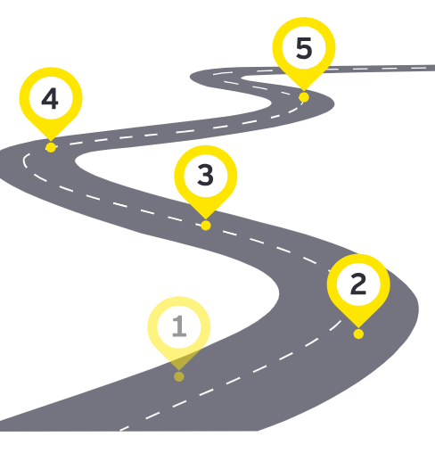
Conclusion | Building the Next-Gen Security Lending Platform
Key takeaway
The future of securities lending is not just about adopting new technology — it requires rethinking and restructuring the market operating model to compete in a rapidly evolving environment.
What will differentiate winners
Platform-led execution: distribution + automation + controls-by-design
Regulatory readiness: auditability, transparency, reporting (e.g., SLATE)
Operational scale: STP, fewer breaks, faster lifecycle processing
The way forward
Market evolution is accelerating (electronification, tighter regulation, and infrastructure modernization), making proactive change management and end-to-end platform execution increasingly important.
Institutions that invest in interoperable solutions and participate in industry-wide collaboration are better positioned to deliver scalable efficiency and meet future market requirements.

